Slide 1
Welcome to OSUIT
Technology Services 918-293-4700

Slide 2
Technology Services 918-293-4700

Slide 3
We coordinate support for all technology resources of the university.
Technology Services 918-293-4700

Slide 4
We provide the server infrastructure for labs, software and storage.
Technology Services 918-293-4700

Slide 5
All campus building are wired for Internet.
Technology Services 918-293-4700

Slide 6
OSUIT doesn’t lock down your access to knowledge.
Technology Services 918-293-4700

Slide 7
Use your O-Key for wireless Internet access in all classrooms and administrative buildings.
Wireless at OSUIT
Technology Services 918-293-4700

Slide 8
Many degree programs make use of mobile devices.
Technology Services 918-293-4700

Slide 9
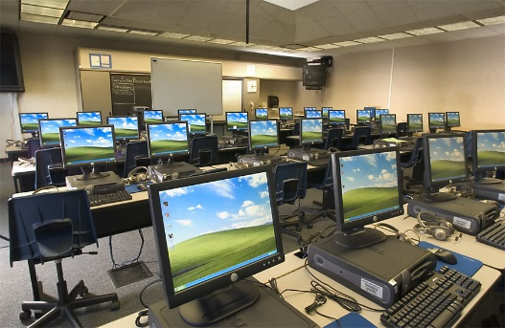
We have over 80 computer labs on our campus.
Technology Services 918-293-4700

Slide 10
The student to computer ratio in OSUIT computer lab courses is 1:1.
Technology Services 918-293-4700
[commons.Wikimedia.org]

Slide 11
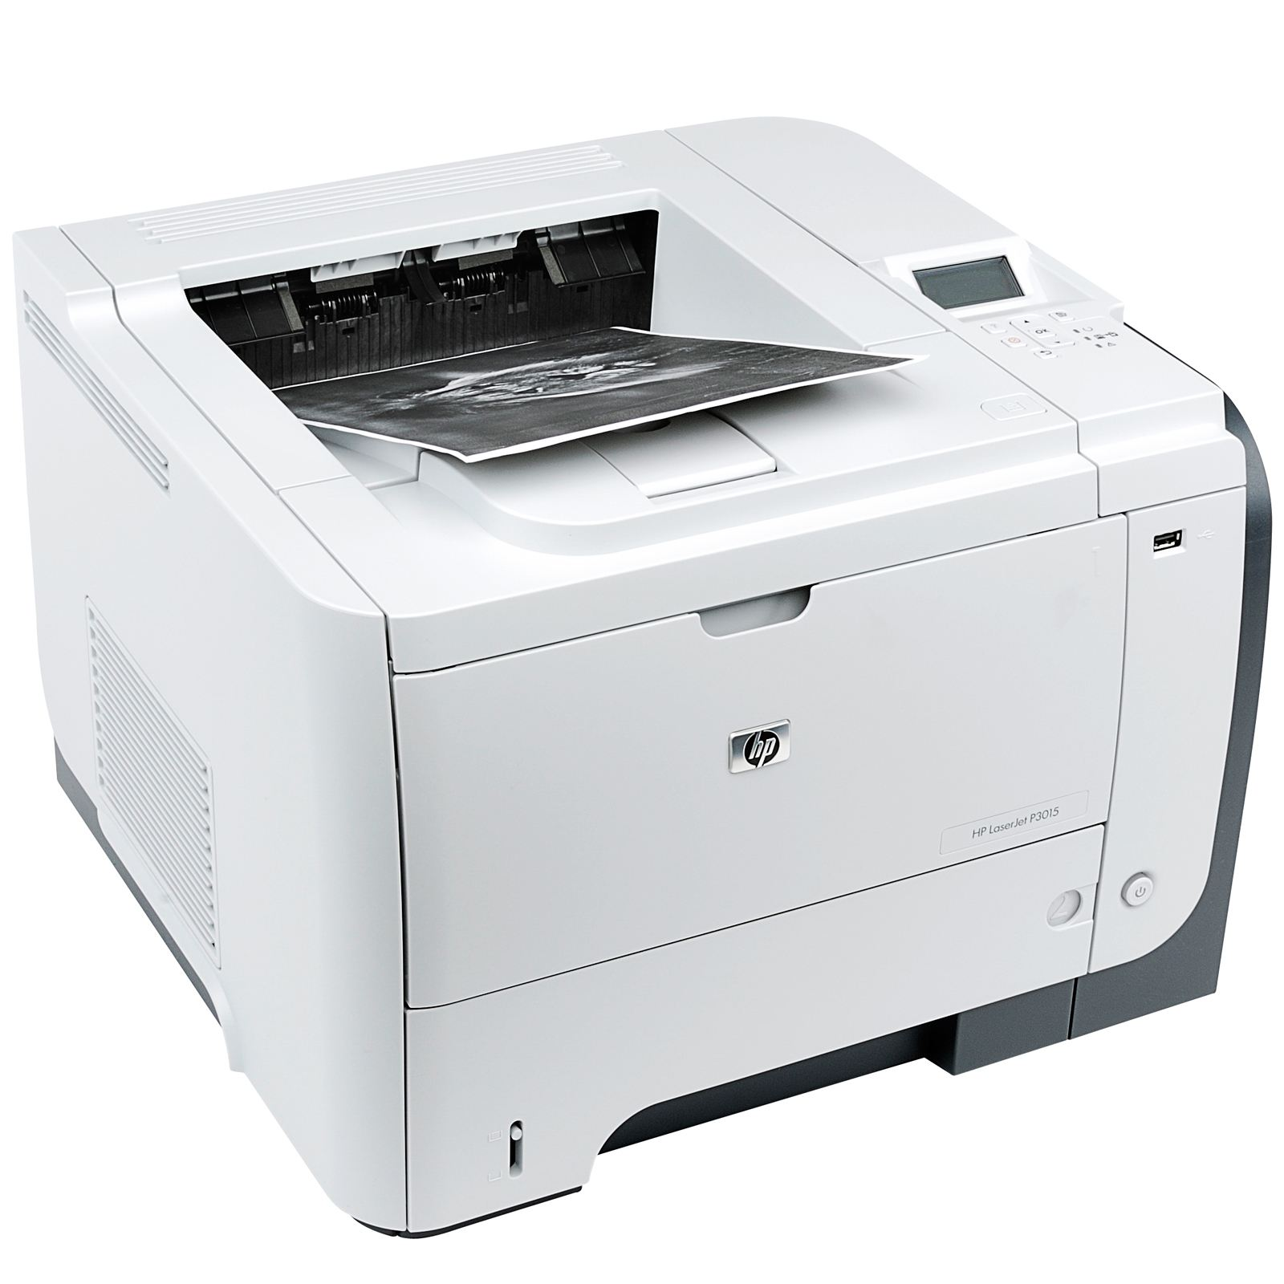
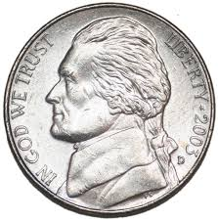
Each student receives 250 free prints per semester in computer labs.
Additional prints in excess of 250 billed at $0.05 each.
Technology Services 918-293-4700

Slide 12
The Technology Service Desk provides services virtually.
Technology Services 918-293-4700

Slide 13
The best way to contact our service desk is by phone at 918-293-4700.
Technology Services 918-293-4700

Slide 14
You can also get help at osuit-servicedesk@okstate.edu
Technology Services 918-293-4700

Slide 15
Our service desk can assist you with diagnosing technology problems.
Technology Services 918-293-4700

Slide 16
Our service desk wants our technology to work for you.
Technology Services 918-293-4700

Slide 17
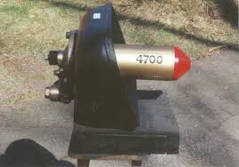
Don’t forget our number.
Technology Services 918-293-4700

Slide 18
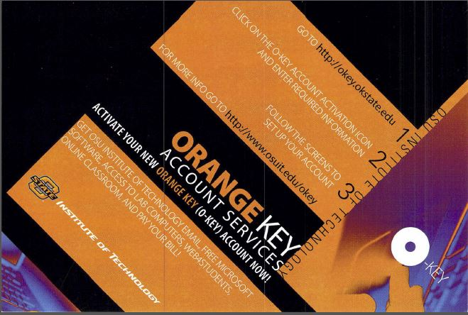
All you need to know about campus technology.
Technology Services 918-293-4700

Slide 19
Activate O-Key, your single sign on key at okey.okstate.edu.
Your O-Key user name has two forms, username and email address.
Example: khulett and kevin.hulett@okstate.edu.
Technology Services 918-293-4700

Slide 20
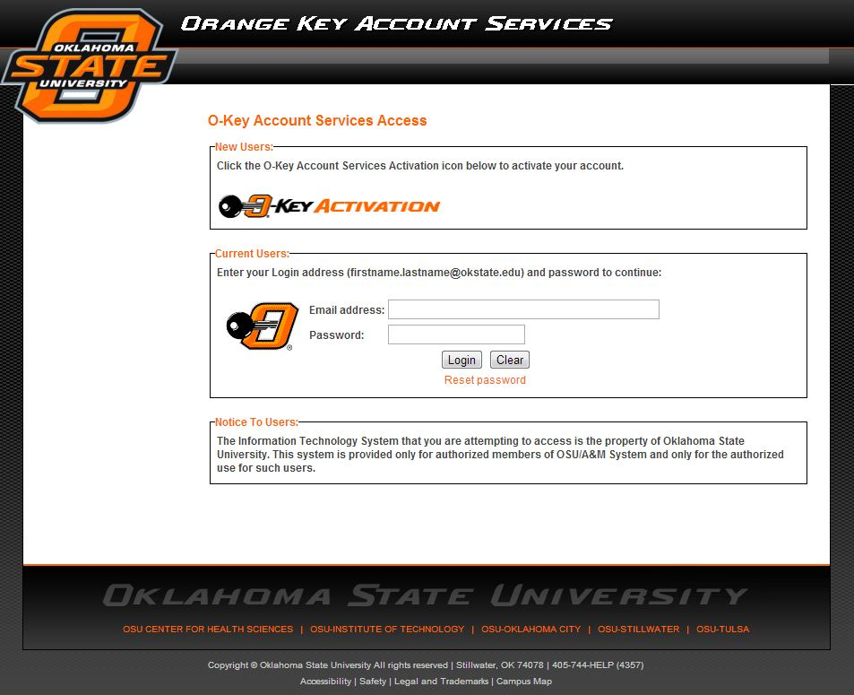
Activate or update your O-Key at okey.okstate.edu.
Technology Services 918-293-4700

Slide 21
Technology Services 918-293-4700

Slide 22
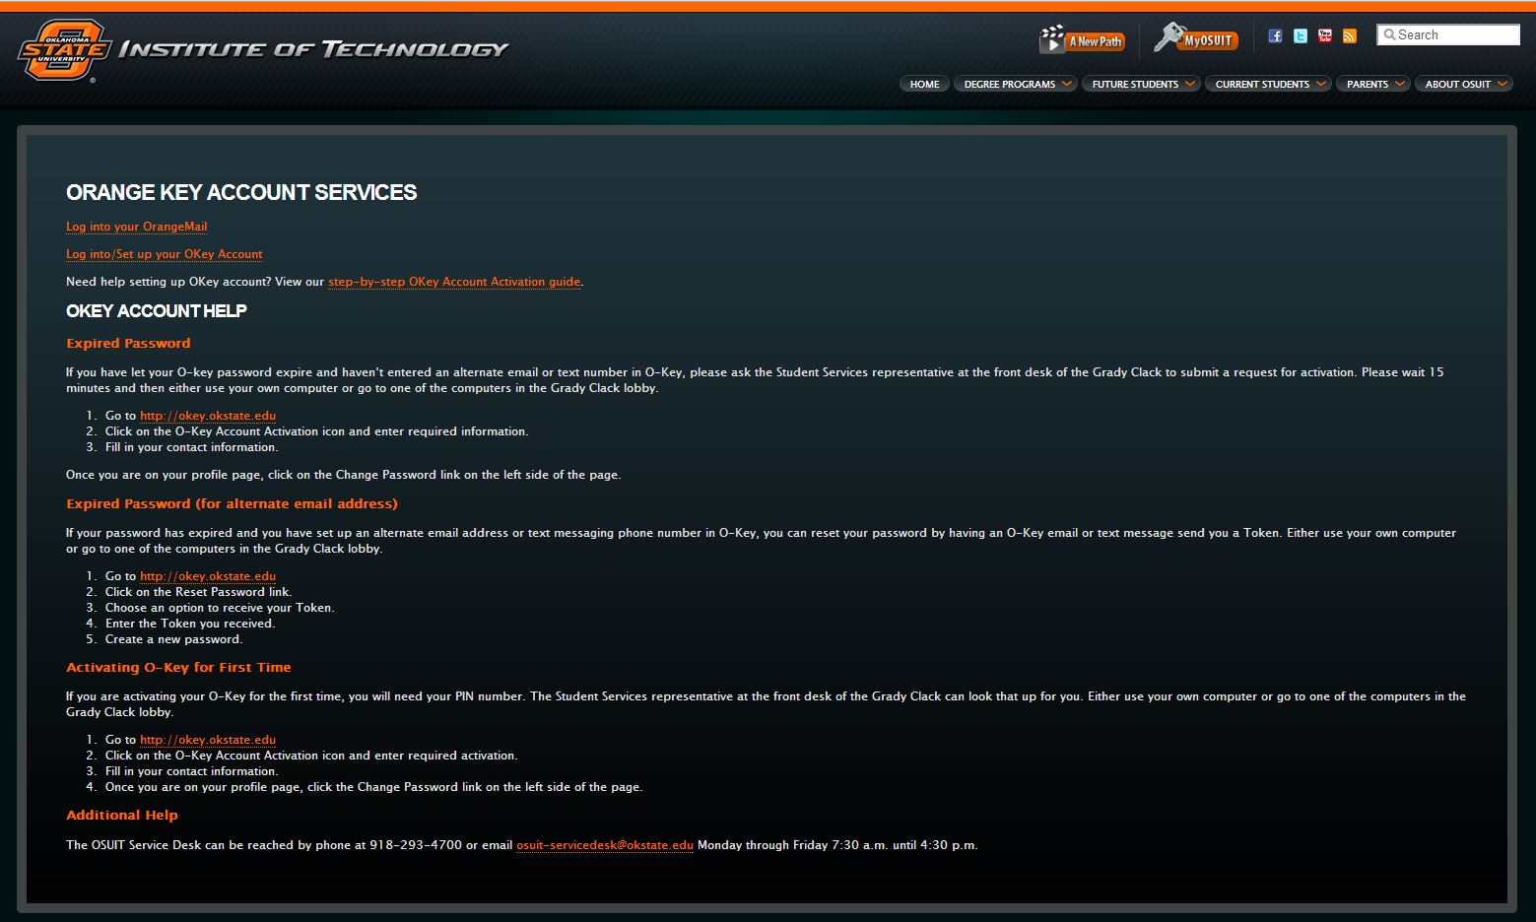
Our website has step-by-step help for activating/resetting your O-Key.
Technology Services 918-293-4700

Slide 23
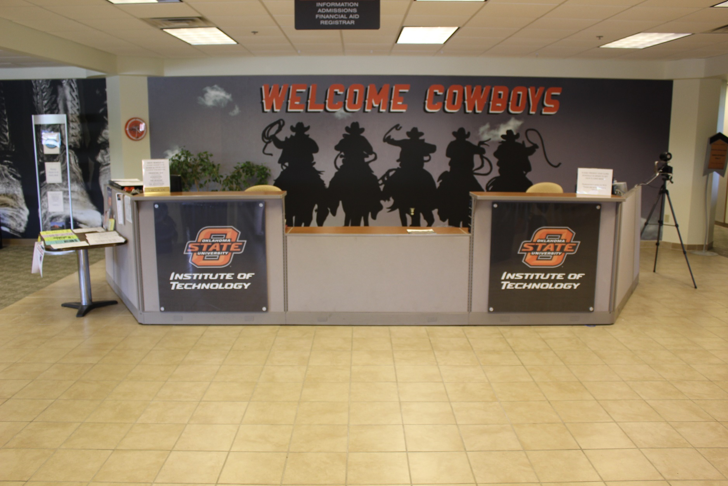
The Grady Clack front desk can assist with O-Key problems.
Technology Services 918-293-4700

Slide 24
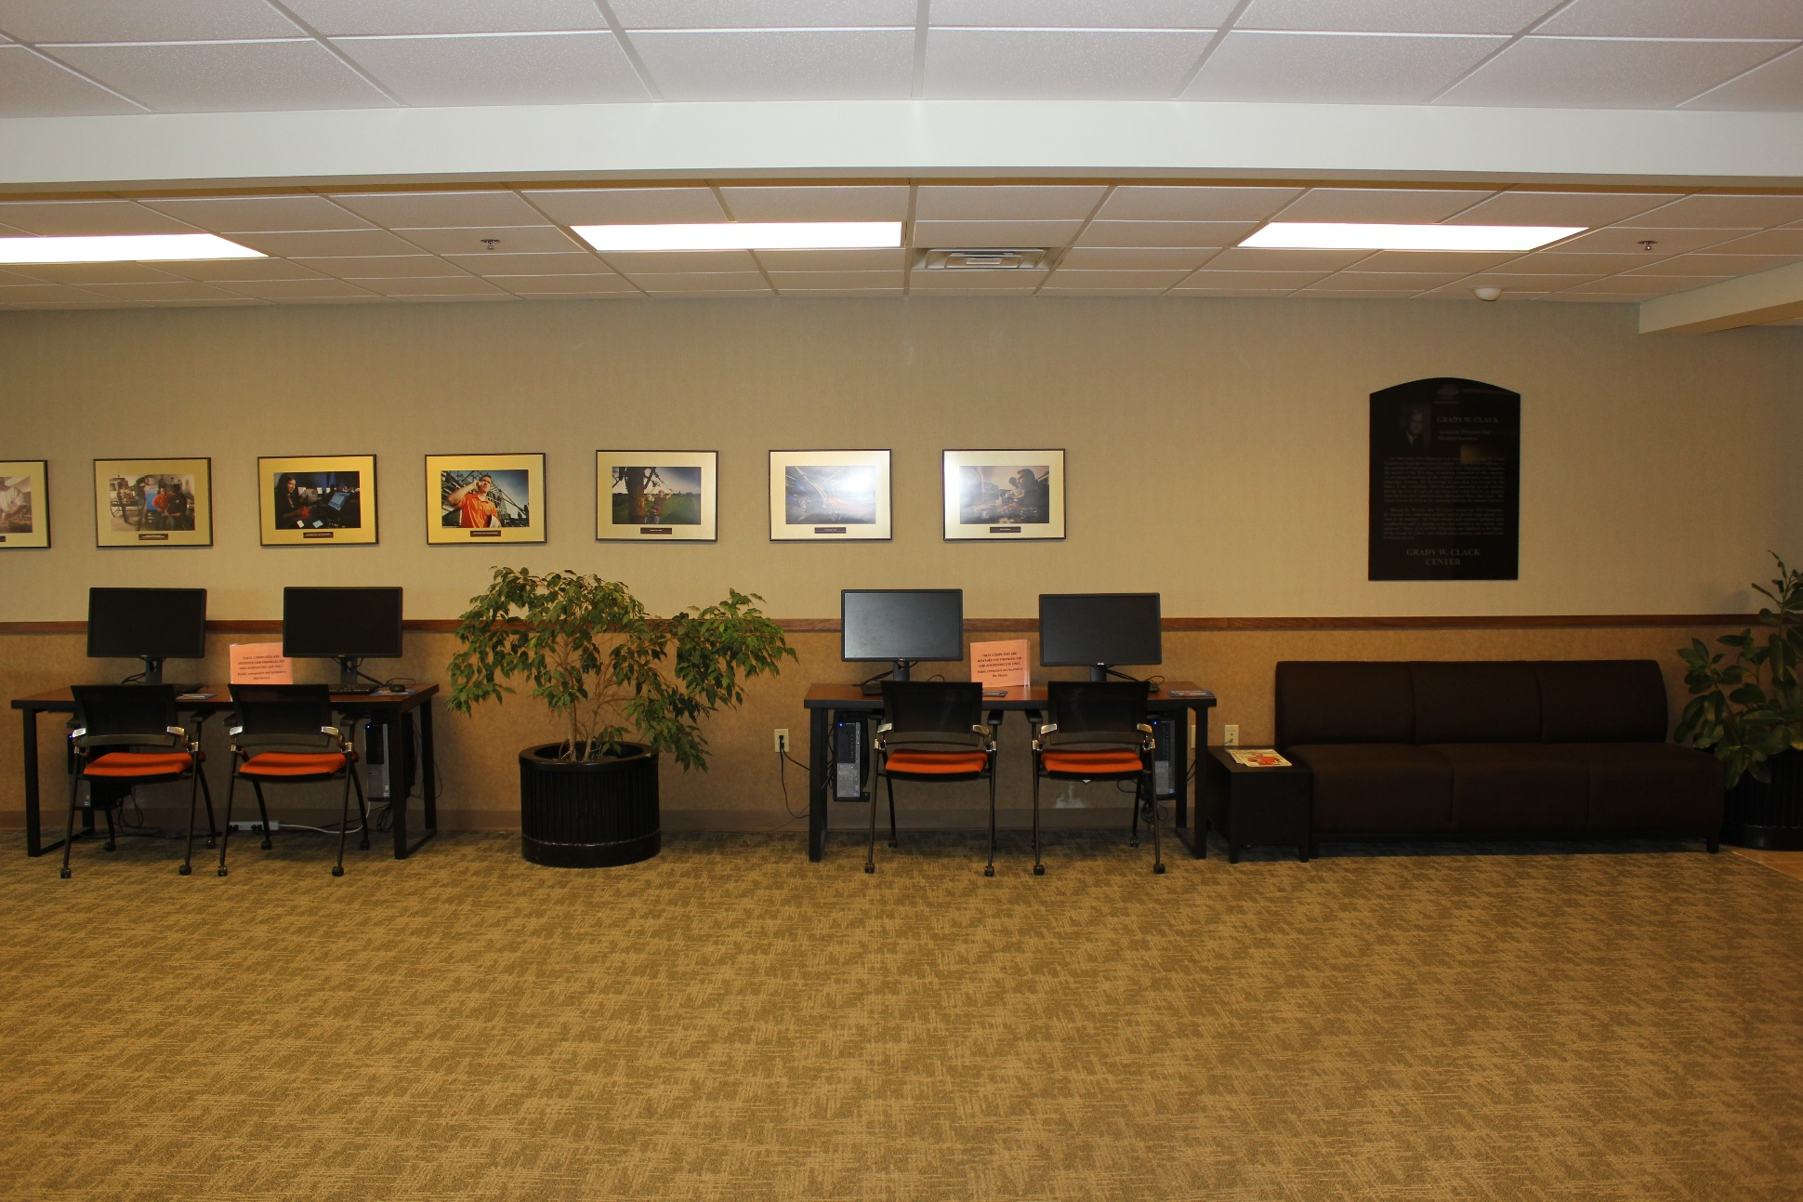
These computers can be used to setup or reset O-Key.
Technology Services 918-293-4700

Slide 25
Be sure and enter a text number in O-Key to get Cowboy Alerts.
Technology Services 918-293-4700

Slide 26
You can download or order software upgrades from app.it.okstate.edu/sdc/
Technology Services 918-293-4700

Slide 27
Does anyone remember the number for the technology service desk?
Technology Services 918-293-4700

Slide 28
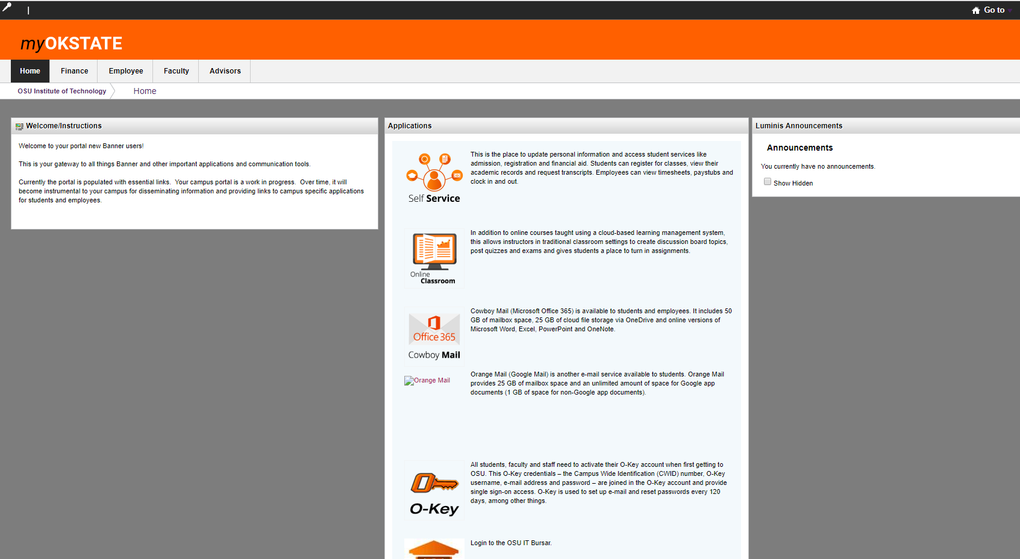
Use my.okstate.edu to get grades, schedules and register.
Technology Services 918-293-4700

Slide 29
Buy or rent textbooks online.
Technology Services 918-293-4700

Slide 30
Get OSUIT discounts from Dell and Apple.
Technology Services 918-293-4700
[apple.com]

Slide 31
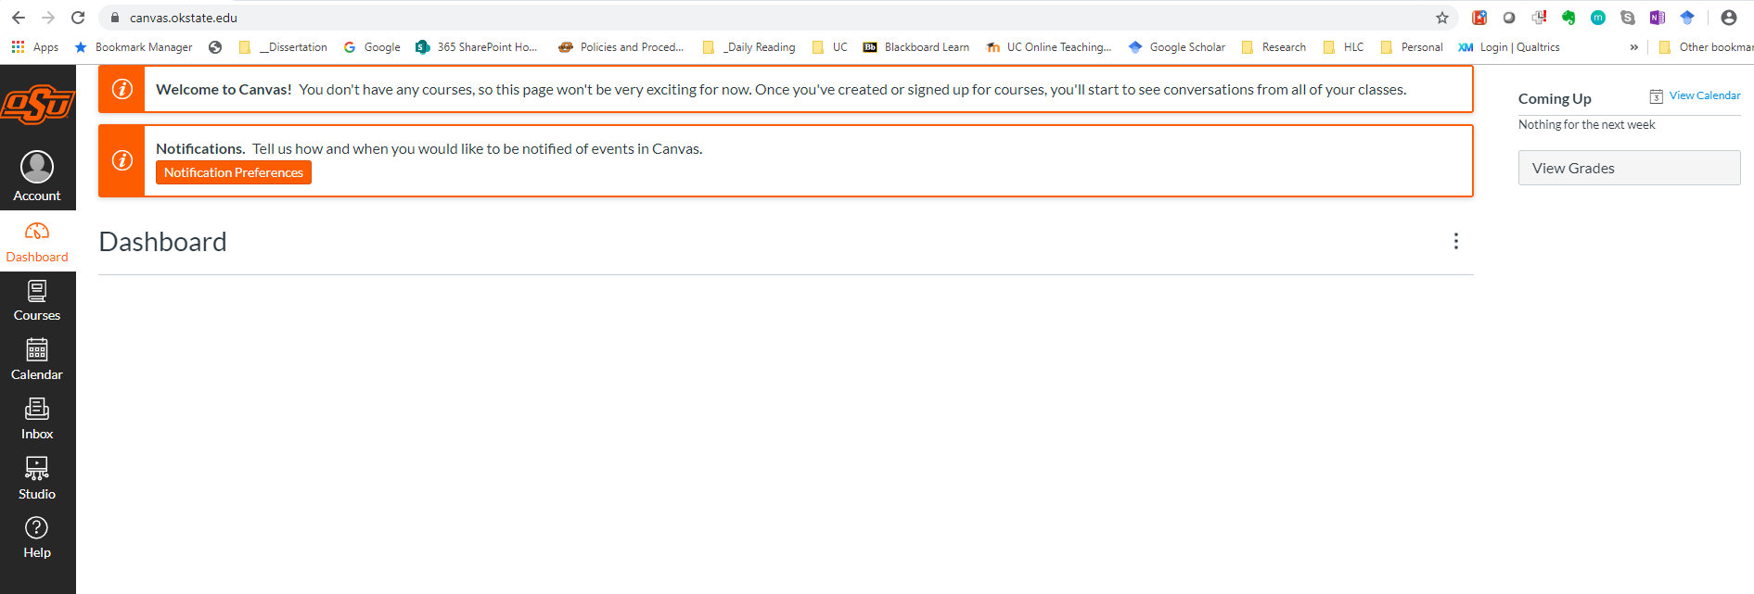
Use your O-Key to log into your Canvas courses at OSUIT.
Technology Services 918-293-4700

Slide 32
Our OSUIT Library provides access to scholarly research databases.
[commons.Wikimedia.org]
Technology Services 918-293-4700

Slide 33
All you need to know about campus technology.
Technology Services 918-293-4700

Slide 34
[osuit.edu]
Technology Services 918-293-4700

Slide 35
Technology Services 918-293-4700

