Slide 1
Closing the Loop on Student Feedback
Student Engagement and Student Satisfaction:
Brief Summary of Results from
CCSSE, SSI, and PSOL

Slide 2
Student Engagement
CCSSE
Community College Survey of Student Engagement
Spring 2015/Spring 2018

Slide 3
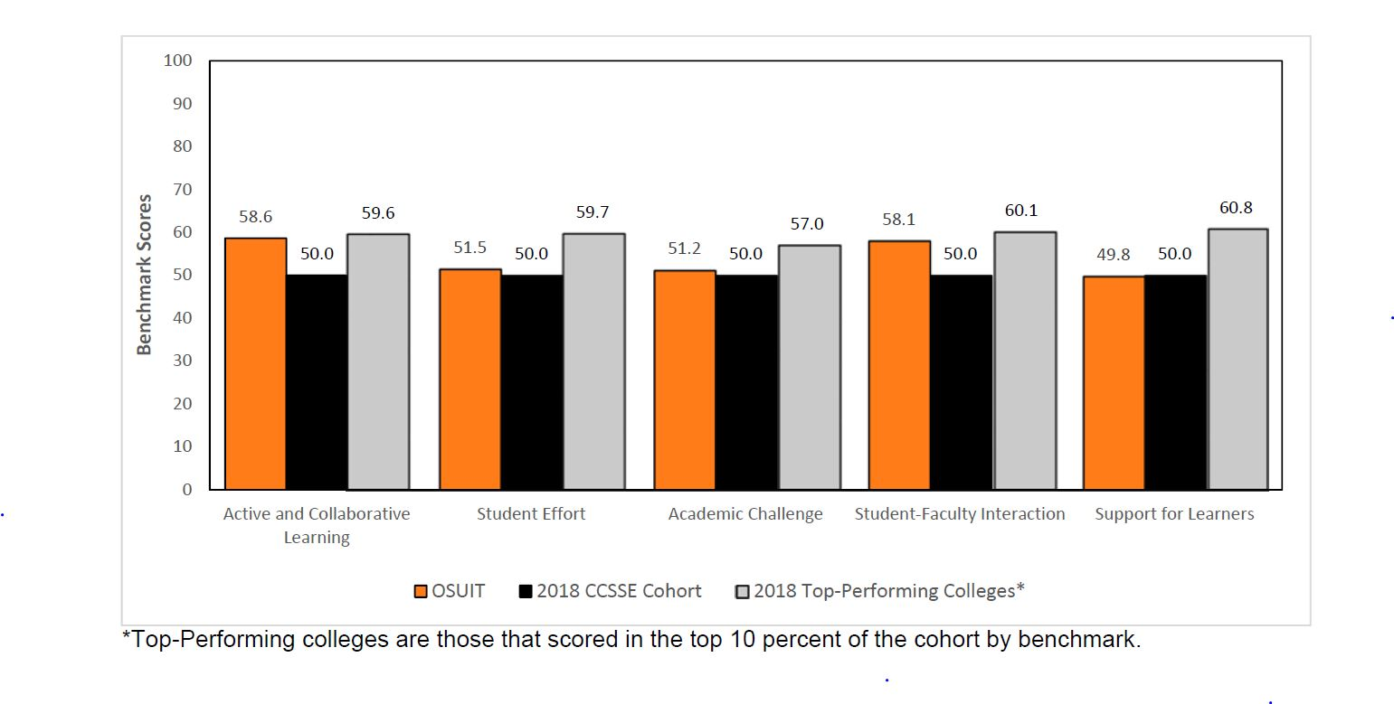

Slide 5
OSUIT’s “Best of Benchmarks” (CCSSE)
Best Indicators of Student Engagement at OSUIT:
Worked with classmates outside of class to prepare class assignments
Talked about career plans with an instructor or advisor
Worked with instructors on activities other than coursework
Frequency: Skill labs (writing, math, etc.)
Frequency: Computer lab

Slide 6
OSUIT’s “Least of Benchmarks” (CCSSE)
Aspects of lowest student engagement at OSUIT
Number of books read on your own (not assigned)
Providing the financial support you need to afford your education
Academic advising/planning
Career counseling
Peer or other tutoring

Slide 7
Academic Mindset of OSUIT Students
CCSSE Special Focus Items

Slide 9
Student Satisfaction Inventory (SSI)
By Scale

Slide 10
STUDENT SATISFACTION INVENTORY - SCALES
Listed from most important to least important in 2018

Slide 11
Priorities Survey for Online Learners (PSOL)
By Scale

Slide 12
PRIORITIES SURVEY FOR ONLINE LEARNERS - SCALES
Listed from most important to least important in 2018

Slide 13
Summary Items
SSI, PSOL, and CCSSE

Slide 14
SUMMARY ITEMS FROM STUDENT SATISFACTION INVENTORY (SSI)

Slide 15
SUMMARY ITEMS FROM PSOL (Online Learners)

Slide 18
Repeated Themes
Five Years of Student Satisfaction
Four Years of Satisfaction for Online Students

Slide 19
Students continue to report high importance and large gap between importance and satisfaction:
I seldom get the run-around when seeking information on this campus. (SSI)
The institution responds quickly when I request information. (PSOL)
Faculty provide timely feedback about my academic progress. (SSI)
Faculty provide timely feedback about student progress. (PSOL)
Tuition paid is a worthwhile investment. (SSI/PSOL)
Quality of instruction/Quality of online instruction (SSI/PSOL)

Slide 20
Reports can be found on the OSUIT Institutional Research website under Reports & Surveys:
osuit.edu/research

