Slide 1
Oklahoma State University
Institute of Technology
Satisfaction Survey Results: 2015
Notes:
SSI and PSOL Results

Slide 2
Noel-Levitz
Satisfaction-Priorities Surveys
Student Satisfaction Inventory (SSI) is for traditional students, primarily enrolled on campus
Priorities Survey for Online Learners (PSOL) for students in online distance learning programs.
Notes:
We’ve been engaged in collecting student satisfaction data since the fall semester 1998 with the SSI which applies to on-campus students. But this year we added a new component:
We now ask our online students about what is important to them as well with the Priorities Survey for Online Learners (PSOL).
********************************************
Institutional Priorities Survey (IPS) for campus faculty, administration and staff is directly parallel to the SSI.
Adult Student Priorities Survey (ASPS) appropriate for undergraduate or graduate adult students.
Adult Learner Inventory (ALI) developed in cooperation with CAEL and appropriate for adult undergrads at four-year or two-year institutions. (Online only)
Parent Satisfaction Inventory (PSI) for parents of currently enrolled students at four-year institutions (Online only)

Slide 3
Matrix for prioritizing action
Very
Important
Institutional
Challenges
Institutional
Strengths
Very
Dissatisfied
Very
Satisfied
Very
Unimportant
©2014 Noel-Levitz
Notes:
Strengths = high importance and high satisfaction. Receive positive information to celebrate. Challenges = high importance and low satisfaction or large performance gap. These are the priorities for focusing resources and improvements. You are not going to worry about the things that are not as important to your students.

Slide 4
Captures three scores for prioritizing
Importance
Satisfaction
Performance Gap
Importance
Importance
Satisfaction
Satisfaction
Notes:
Same for both:
Students respond twice to each item – first by indicating how important an item is, and then again to indicate how satisfied they are with that item. These surveys use a 7-point Likert scale with 7 being high or positive. Importance minus satisfaction gives us a performance gap score. The smaller the performance gap, the better we are at meeting our students’ expectations; the larger the gap, the more room we have for improvement.

Slide 5
OSUIT 2015
Student Satisfaction Inventory (SSI)
Survey completed in spring semester 2015
Forty classes chosen, quasi-random
Paper and pencil administration in class
359 students, response rate of 71.2%
Notes:
Let’s start with the SSI: Administered this past spring, from among the classes not chosen for the Community College Survey of Student Engagement (CCSSE), 40 of the remaining classes were selected at random. 71% of students registered in these classes completed the SSI.

Slide 6
SSI Demographics
Gender: 32% Female, 68% Male
Age: 71% 24 and younger; 29% 25 and older
Ethnicity: 65% Caucasian; 18% Native American
Enrollment status: 90% Full-time
Class level: 46% first-year, 39% second year
Employment: 20% full-time, 45% part-time
Notes:
The students were reasonably representative of the campus community…68% male, 71% under the age of 25, 65% white, 18% native American, 90% full-time students, most were first or second year students, and 20% worked full-time. There are some differences, you’ll see, when we look at the demographics for the PSOL in a few minutes.

Slide 7
Scales in order of importance
Notes:
So, let’s look at what matters to our on-campus students.

Slide 8
SSI Scales listed in descending order of importance to our students
Academic advising effectiveness
Instructional effectiveness
Registration effectiveness
Campus climate
Student centeredness
Admissions and financial aid effectiveness
Campus services
Safety and security
Notes:
In terms of importance, our students placed highest value on Academic Advising Effectiveness. They placed the least value on Safety and Security. Keep this in mind when we look at our Strengths and Challenges in a minute.

Slide 9
OSUIT, Spring 2014: SSI National Comparison
Top items with higher satisfaction:
My academic advisor is available when I need help.
My academic advisor is knowledgeable about my program requirements.
My advisor helps me apply my program of study to career goals.
Item with lowest satisfaction:
On the whole, the campus is well-maintained.
The amount of student parking space on campus is adequate.
Parking lots are well-lighted and secure.
Tuition paid is a worthwhile investment.
The campus is safe and secure for all students.
There are convenient ways of paying my school bill.
Notes:
Compared to other schools nationally, our higher satisfaction items focus on advisement– academic advisor is available, knowledgeable, and can help students on the path to a career.
Lowest satisfaction items deal more with security and convenience–in parking and lighting, but remember that security issues were also least on students’ list of priorities; safety and security are reportedly more of a concern for students at other colleges.

Slide 10
Strategic Planning Overview:
Strengths and challenges
Notes:
Comparing ourselves to a national benchmark is important, but the primary way to review the results is by looking at our own strengths and challenges.

Slide 11
OSUIT, Spring 2015: Our Strengths (SSI)
The quality of instruction I receive in most of my classes is excellent.
My academic advisor is knowledgeable about my program requirements.
I am able to register for the classes I need with few conflicts.
My advisor helps me apply my program of study to career goals.
The campus is safe and secure for all students.
The campus staff are caring and helpful.
My academic advisor is available when I need help.
This campus provides online access to services I need.
Students are made to feel welcome here.
Faculty are usually available to students outside of class (during office hours, by phone, or by e-mail).
Computer labs are adequate and accessible.
Registration processes and procedures are convenient.
Notes:
Strengths are items of high importance and high satisfaction. Several items deal with advisement and registration.

Slide 12
OSUIT, Spring 2015: Our Challenges (SSI)
The quality of instruction I receive in most of my classes is excellent.
Campus item 2: “My department prepares students well for their professions.”
Campus item 3: “My academic advisor adequately assists me with career planning issues.”
Faculty provide timely feedback about my academic progress.
Tuition paid is a worthwhile investment.
The amount of student parking space on campus is adequate.
Classes are scheduled at times that are convenient for me.
Financial aid awards are announced in time to be helpful in college planning.
Notes:
Challenges are items of high importance and low satisfaction or a substantial performance gap. “Quality of Instruction” was listed as a strength, and most important on the previous slide, but there is enough of a gap between importance and satisfaction that there is room for improvement.

Slide 13
Summary scores
Notes:
We also have the summary items for a bottom-line look at overall satisfaction. Here, we focus on the percentage of responses by students who are satisfied or very satisfied.

Slide 14
OSUIT, Spring 2015: SSI Summary Scores
Percent of students’ expectations better to much better than expected
Percent of students satisfied or very satisfied with their experience thus far
Percent of students probably or definitely likely to re-enroll, given the opportunity
Notes:
These are compared to the national average.
46% of our students found that their college experience was better or much better than expected;
57% overall were satisfied or very satisfied with their experience thus far;
65% would probably or definitely do it again, given the opportunity.

Slide 15
OSUIT, Spring 2015: SSI Factor to Enroll
Notes:
There is a section at the end of the survey, rated for importance only, that provides information for marketing and admissions or prospective students. Everyone is looking for career opportunities, and academic reputation is almost as important as how much it will cost to come here.
Also note that each of these items was rated as less important than the average national ratings. Our students, in general, tend to report lower ratings across the board. Whether it has something to do with economics, or history, or religious affiliation, students who attend OSUIT either have more conservative ratings; or, perhaps nationally, students may be more idealistic and have a tendency to inflate their ratings.
*******************************************************End narrative here.
I believe our students may be more serious about their education when compared to the national group that includes community and liberal arts colleges.

Slide 16
Student Satisfaction
Trend Report
Notes:
The following slides show trends for OSUIT starting with 2001 up through the present.

Slide 17
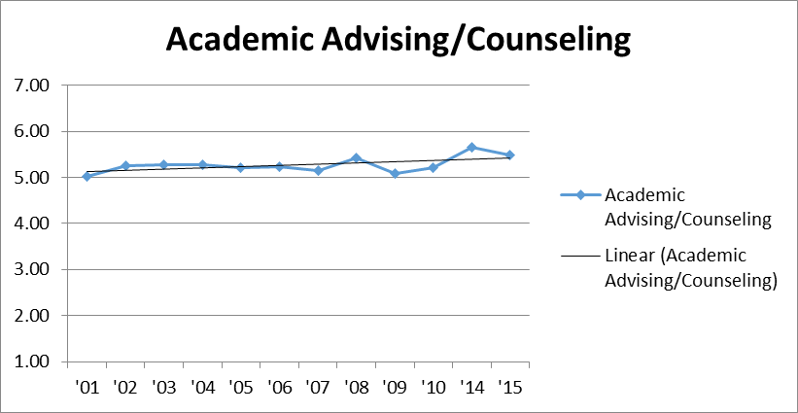
Compare to historical data, graphs
Notes:
There was a period of three years when we did not administer the SSI, so the timeline jumps from 2010 to 2014. At that time, we started using the shorter 40-item form B, and in 2014, we attempted to gather the data through online administration. We have since returned to paper and pencil administration in the classrooms for better response rates. As you will see, there was a bump of higher satisfaction in 2014, but it was likely due to the method of administration and, in some cases, may have been impacted by the use of incentives. This may also suggest a reason why our students tend to report lower ratings overall than the national average; other schools are known to use incentives as we were encouraged to do by the folks at Noel Levitz. Nevertheless, satisfaction on this campus has shown an increase using data available over the last 15 years. Here’s Academic Advising/Counseling…

Slide 18
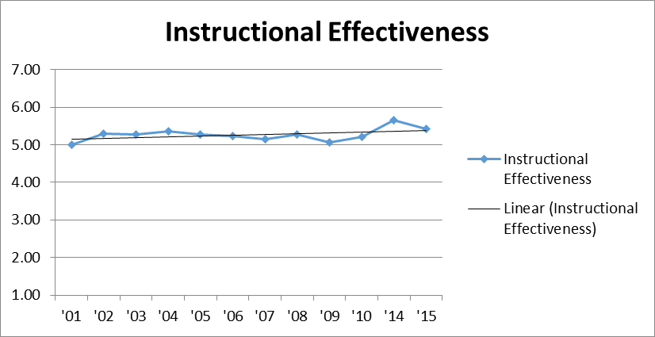
Compare to historical data, graphs
Notes:
Instructional Effectiveness…

Slide 19
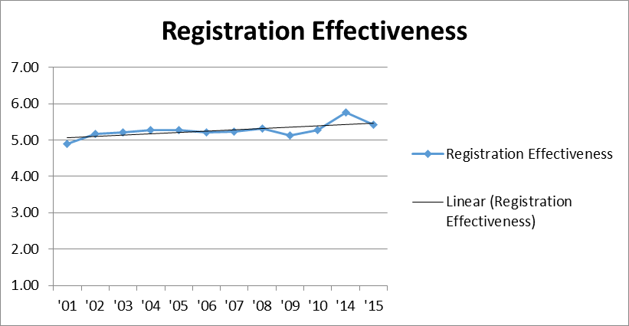
Compare to historical data, graphs
Notes:
Registration Effectiveness…

Slide 20
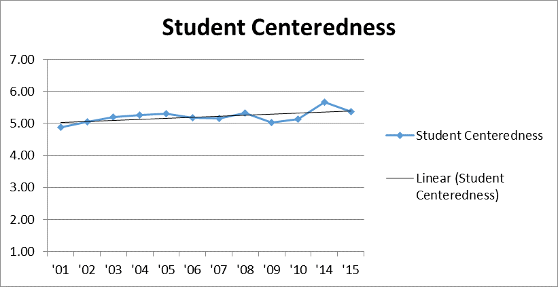
Compare to historical data, graphs
Notes:
Student Centeredness…

Slide 21
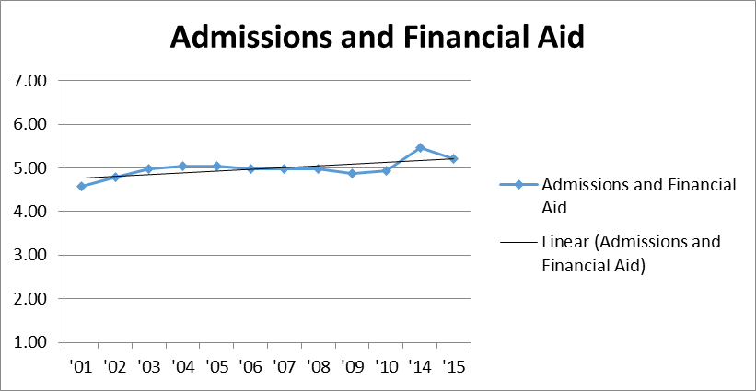
Compare to historical data, graphs
Notes:
Admissions & Financial Aid…

Slide 22
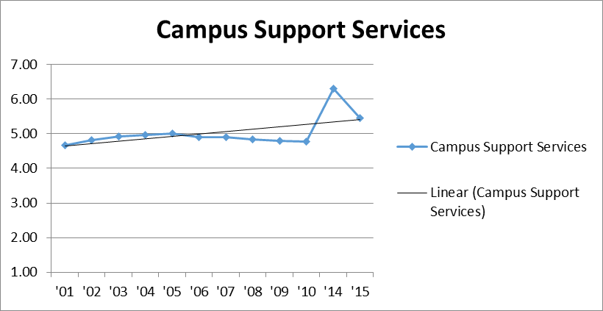
Compare to historical data, graphs
Notes:
Campus Support Services…

Slide 23
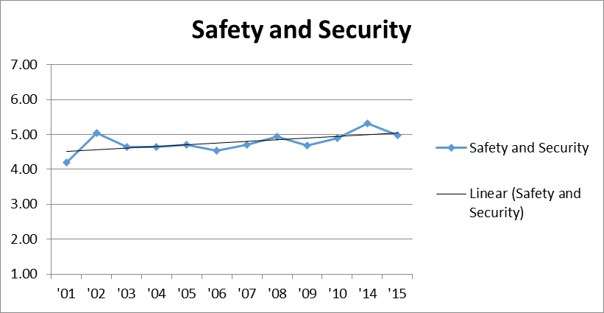
Compare to historical data, graphs
Notes:
And Safety & Security. Least important to the students, correspondingly low satisfaction, but continues a positive trend.

Slide 24
OSUIT 2015
Priorities Survey for Online Learners (PSOL)
Survey completed in spring semester 2015
All online and hybrid class students invited
Online administration only
247 students, response rate of 32.4%
Notes:
Now, let’s take a look at the Priorities Survey for Online Learners (PSOL). According to Noel Levitz, students in online classes have different needs, expectations, and priorities than traditional students. This instrument was modeled on the SSI but was crafted for distance learners. It is not available in paper-and-pencil form– only online administration.
Survey completed in spring semester 2015; all online and hybrid class students were invited. 247 students gave us a response rate of 32.4%

Slide 25
OSUIT, Spring 2015: PSOL Demographics
Gender: 47% Female, 53% Male
Age: 45% 24 and younger; 55% 25 and older
Ethnicity: 65% Caucasian; 19% Native American
Enrollment status: 72% Full-time, 28% Part-time
Class level: 26% first-year, 32% second year, 35%>
Notes:
Those who completed the PSOL are a little different from the overall OSUIT student population:
47% Female, 53% Male
55% 25 and older
35% were 3rd or 4th year students.

Slide 26
OSUIT, Spring 2015: PSOL Demographics
Most classes taken where?
Online, 43.6%
Okmulgee campus, 53.5%
Pryor campus, 1.7%
Career tech campus, 1.2%
Employment:
Full-time, 45%
Part-time, 26%
Not employed, 33%
Notes:
44% took most of their classes online, and 45% were holding down full-time jobs.

Slide 27
Programs/Majors of PSOL respondents
Notes:
38% (95/247) were IT majors, so they are heavily represented, followed by nursing and gen-ed majors, then engineering.

Slide 28
Scales in order of importance
Notes:
So, let’s look at what matters to our online students.

Slide 29
PSOL Scales listed in descending order of importance to our students
Institutional Perceptions
Enrollment Services
Academic Services
Instructional Services
Student Services
Notes:
There are five scales on the PSOL, and here they are in rank order according of importance: Institutional Perceptions, followed by Enrollment Services, Academic Services, Instructional Services, and Student Services.

Slide 30
OSUIT, Spring 2015: PSOL National Comparison
Top items with higher satisfaction:
The Online Classroom (D2L) is easy to use.
My program advisor is accessible by telephone and e-mail.
The bookstore provides timely service to students.
Billing and payment procedures are convenient for me.
Registration for online courses is convenient.
Item with lowest satisfaction:
Tutoring services are readily available for online.
Channels are available for providing timely responses to student complaints.
The quality of online instruction is excellent.
Faculty provide timely feedback about student progress.
Notes:
Compared to the national average, highest satisfaction on this campus included the Online Classroom D2L, advisor accessibility, the bookstore, billing and payment procedures, and registration that is convenient.
Lowest satisfaction was with tutoring services, response mechanisms dealing with student complaints, quality of instruction, and timely feedback regarding student progress.

Slide 31
OSUIT, Spring 2015: Our Strengths (PSOL)
My program advisor is accessible by telephone and e-mail.
I am aware of whom to contact for questions about programs and services.
Billing and payment procedures are convenient for me.
The Online Classroom (D2L) is easy to use.*
*OSUIT custom item.
Notes:
Strengths identified by the PSOL:
My program advisor is accessible by telephone and e-mail.
I am aware of whom to contact for questions about programs and services.
Billing and payment procedures are convenient for me.
The Online Classroom (D2L) is easy to use.* This was a custom item we added to the survey.

Slide 32
OSUIT, Spring 2015: Our Challenges (PSOL)
Instructional materials are appropriate for program content.
Faculty provide timely feedback about student progress.
Tuition paid is a worthwhile investment.
Program requirements are clear and reasonable.
This institution responds quickly when I request information.
The quality of online instruction is excellent.
Faculty are responsive to student needs.
When applicable, there is sufficient additional hands-on experience in my major.*
*OSUIT custom item.
Notes:
The challenges:
Instructional materials are appropriate for program content.
Faculty provide timely feedback about student progress.
Tuition paid is a worthwhile investment.
Program requirements are clear and reasonable.
This institution responds quickly when I request information.
The quality of online instruction is excellent.
Faculty are responsive to student needs.
When applicable, there is sufficient additional hands-on experience in my major.* This was also a custom item we added.

Slide 33
Summary scores
Notes:
Here we have results for the summary items; however, since this is the first time we’ve done the PSOL, I thought it appropriate to show the distribution of the responses rather than just the positive responses. Let me show you why…

Slide 34
PSOL Summary Scores: So far, how has your college experience met your expectations?
Notes:
For online learners, a large portion seem to know what they are getting into. Compared to the SSI, the PSOL students are generally older and more experienced in the educational process.

Slide 35
PSOL Summary Scores: Rate your overall satisfaction with your experience here thus far.
Notes:
55% percent of students indicated, overall, that they were satisfied or very satisfied with their experience thus far.

Slide 36
PSOL Summary Scores: All in all, if you had to do it over, would you enroll here again?
Notes:
65% of students indicated that they would probably or definitely re-enroll.

Slide 37
Sources of Information: Online Learners at OSUIT
Notes:
Where do they get their information about online classes? Students get their information from the website, through recommendations of advisors and instructors, and using the online catalog. Printed materials and advertising seem to be less important, but this may make sense if the students are older and more savvy about offerings at OSUIT.

Slide 38
OSUIT, Spring 2015: PSOL Factors to Enroll
Notes:
Factors to enroll in online classes: The online students want convenience, flexibility, and employment opportunities, and they want to keep their costs down.

Slide 39
Step three: Responding to the data with new initiatives
Notes:
So, what so we do with this information?
We begin working on the challenges and celebrate our strengths.

Slide 40
Three key ways to build on strengths
1
Provide positive feedback to the campus
2
Use high performing areas as models for other departments
3
Incorporate your strengths into your recruitment and marketing messages
Notes:
Communicate and share positive feedback with all areas on campus. Use the strengths as talking points with students and stakeholders.

Slide 41
Three key ways to respond to challenges
1
Easy, immediate response items, i.e., “just do it”
2
Incorporate into long term, strategic plan
3
Change perceptions with information
Notes:
As for challenges:
1. Some things should be addressed quickly, either because they appear to be mission-critical, or because it is convenient or simple to fix.
2. Other items might work their way into the strategic plan depending on the complexity of the challenge.
3. Whatever we do, we need to let the students know; this can help change perceptions about what they expect out of us and lets them know that we value their feedback.

Slide 42
OSUIT Institutional Research
Michelle Canan, Director
Curtis Miller, Analyst
osuit.edu/research/

